Slide 1
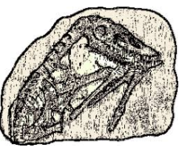
Fossil Evidence for Evolution
Fossil Formation
Fossil Discovery
Absolute Dating

Slide 2
Date: | Human Biology Year 12 ATAR
Do Now Past Exam Question – sequencing and evidence for evolution Lesson Agenda 1: Do Now 2: Fossils and Absolute Dating Techniques 3: Lesson Summary and Wind Up Suggested Study Read through today’s notes and textbook section Complete review worksheet, then mark and correct using the answer key on Connect (compulsory). NEXT LESSON Fossil Evidence and Relative Dating Techniques | Learning Aims Describe the main processes of fossilisation Explain the conditions required for fossilisation to occur. Discuss how fossils are discovered and excavated Define absolute dating and relative dating Describe how K-Ar dating works and discuss its limitations Describe how Radiocarbon dating works and discuss its limitations Use given data to calculate the age of a sample using a graph
 | Key Vocabulary Isotope Half-life Fossil

Slide 3
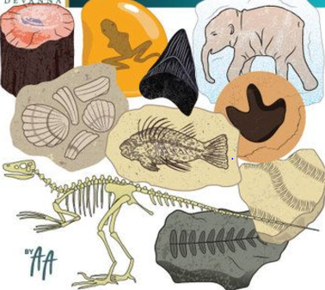
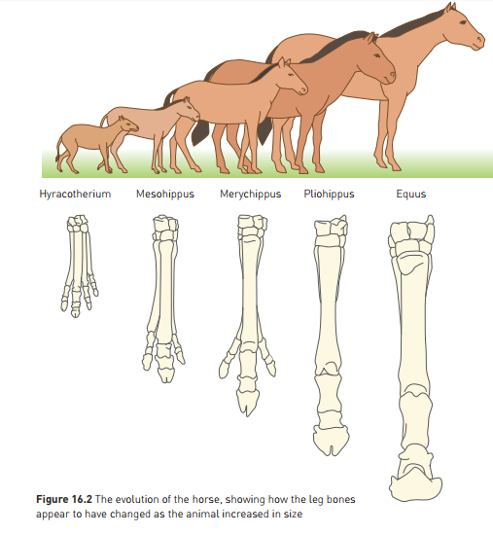
Overview/Intro
Fossil record is one of the crucial pieces of evidence for evolution
Fossil: a preserved trace left by an organism that lived long ago:
Footprints, Burrows, Faeces, Impressions (trace fossils)
Bones, Shells, Teeth, Soft tissues (body fossils)
Not all remains and traces become fossilised. It happens rarely, so there are many extinct creatures where there is no fossil record.
Materials associated with the fossils also helps to provide information:
Rock they were found in
Other fossils nearby
Some fossil evidence can show an evolutionary sequence eg evolution of horse hoof.

Slide 4
Processes of Fossilisation
Fossils can form in different ways:
PERMINERALISATION
After burial in sediment, minerals are deposited into the remains by water. This slowly replaces the remains with mineral, petrifying them.
Many fossil bones and petrified wood are fossilised in this way.
PRESERVED REMAINS
The entire organism and its tissues are preserved
Eg: insects in amber, mammoths in ice, Neolithic humans in peat bogs
MOLDS AND CASTS
Original remains dissolve leaving a space “mold” that is later filled with other sediments “cast”.
Eg: imprints of shells or other soft bodied creatures, footprints etc.
Learning Aim: Describe the main processes of fossilisation

Slide 5
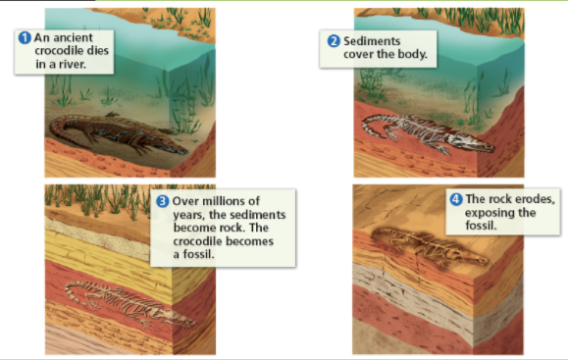
Learning Aim: Describe the main processes of fossilisation

Slide 6
Conditions for Fossilisation
Not all remains become fossils
Fossilisation requires:
Rapid Burial
Prevents decomposition or destruction of the remains
Can be buried by:
Mud/Sediment deposits in riverbed
Drifting sand
Volcanic Ash
Deliberate burial (human funeral burials)
Favourable Soil Conditions
Higher pH (alkaline soils) – mineral deposits replace tissues better in alkaline soils
Low oxygen environment – slows decomposition of soft tissues
Absence of decay organisms
Long Periods of Geological Stability
Learning Aim: Explain the conditions required for fossilisation to occur.

Slide 7
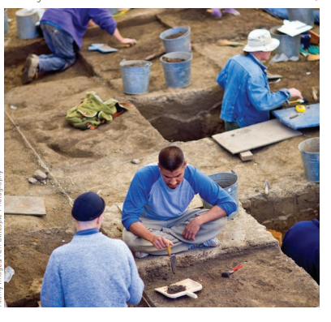
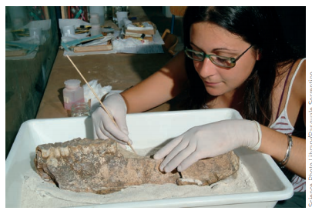
Fossil Discovery
Geological processes such as erosion mean fossils eventually resurface
Fossils can be found:
By chance, on surface: indication of good place to look for more: digging
By geological survey – looking at rock for indicators that it may have been favourable for fossil formation.
Digging for fossils:
Area surveyed, marked into sections
Small hand tools remove soil
Soil is sieved to catch small fossil parts
Artefacts (carvings, tools) may also be found with human ancestral remains
Photos taken at each stage of dig
Labelled and catalogued
Final cleaning, repair and piecing together in the lab.
Learning Aim: Discuss how fossils are discovered and excavated.

Slide 8
Dating of Fossils
Dating: determining the age of material
Many methods, may provide:
Absolute dates: approximate age in years
Relative dates: whether sample is older of younger than a comparison sample.
Modern technology allows accurate estimates of absolute date.
Absolute Date years given in years before present (BP)
Eg: 45000 years BP = 45000 years old.
Learning Aim: Define absolute dating and relative dating.

Slide 9
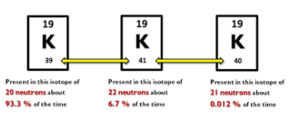
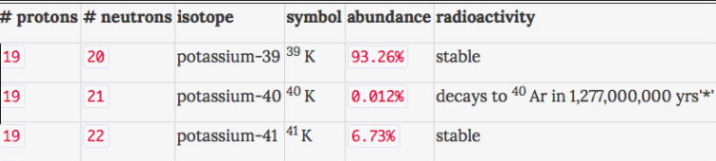
Absolute Dating: Potassium – Argon Technique
Method based on decay of radioactive potassium into calcium and argon.
Potassium: 3 different forms (isotopes)
Learning Aim: Describe how K-Ar dating works and discuss its limitations

Slide 10
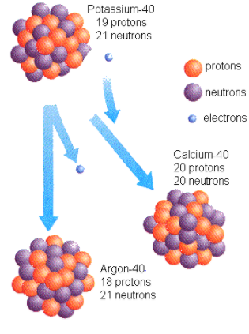
Absolute Dating: Potassium – Argon Technique
Potassium-40:
Unstable potassium isotope - radioactive
Decays to form Calcium-40 and Argon-40
Decay happens at a very slow but constant rate
Determining relative proportions of K-40 and Ar-40 in a rock allows age of the rock to be calculated
“half life” is the time it takes for the amount of K-40 to halve
K-40 half life is 1.25 billion years
Limitations of Potassium-Argon Dating
Limited usefulness
Not all rock types suitable
Can only date rocks older than 200 thousand years, as it takes so long to decay enough to measure.
Gives a precise date where it can be used.
Learning Aim: Describe how K-Ar dating works and discuss its limitations

Slide 11
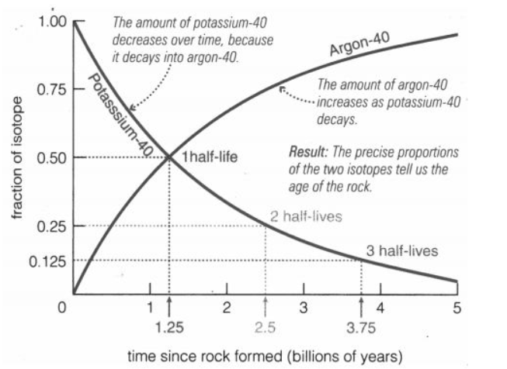
Learning Aim: Describe how K-Ar dating works and discuss its limitations

Slide 12
Activity: Potassium- Argon Dating simulation
Learning Aim: Describe how K-Ar dating works and discuss its limitations

Slide 13
Absolute Dating: Carbon-14 / Radiocarbon dating
Living things contain carbon. They get this carbon via the food chain. Plants get it from CO2 in the atmosphere, and animals get it via the rest of the food chain. Most of the carbon in the atmosphere, and therefore in living things is the Carbon-12 isotope, which is stable.
A small amount of carbon in living things is the Carbon-14 isotope, which is unstable.
Carbon-14 exists in atmosphere in small amounts
Taken up by plants during photosynthesis, passes along food chain
Becomes part of living tissues
After death, intake ceases, and carbon-14 decays into nitrogen at a fixed rate
We can work out how long a carbon based life form has been dead for by looking at the ratio of carbon-14 (radioactive) to carbon-12 (stable).
Learning Aim: Describe how Radiocarbon dating works and discuss its limitations

Slide 14
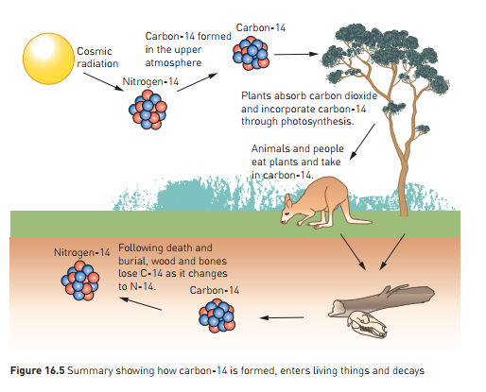
Learning Aim: Describe how Radiocarbon dating works and discuss its limitations

Slide 15
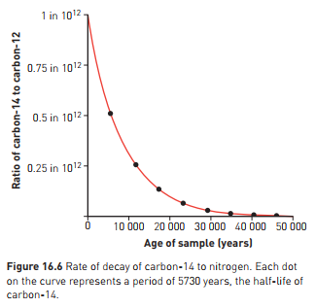
Absolute Dating: Carbon-14 / Radiocarbon dating
In living organisms, the ratio is:
1 carbon-14 : 10¹² carbon-12
The amount of Carbon-14 halves each 5730 years. This is the “Half Life” of Carbon 14.
If we measure the ratio, we can use the graph to determine the age of the sample.
Learning Aim: Describe how Radiocarbon dating works and discuss its limitations

Slide 16
Absolute Dating: Carbon-14 / Radiocarbon dating
Normal method requires 3 grams of carbon
Newer technique: Accelerator Mass Spectrometry (AMS) radiocarbon dating – can work with 100ug.
Can date using tiny samples
Limitations of Radiocarbon dating:
After 70000 years, not much of sample left
Can only use for samples younger than this
Material tested must contain Carbon.
Some margin of error due to fluctuating Carbon-14 in the atmosphere
Learning Aim: Describe how Radiocarbon dating works and discuss its limitations

